Slide 1

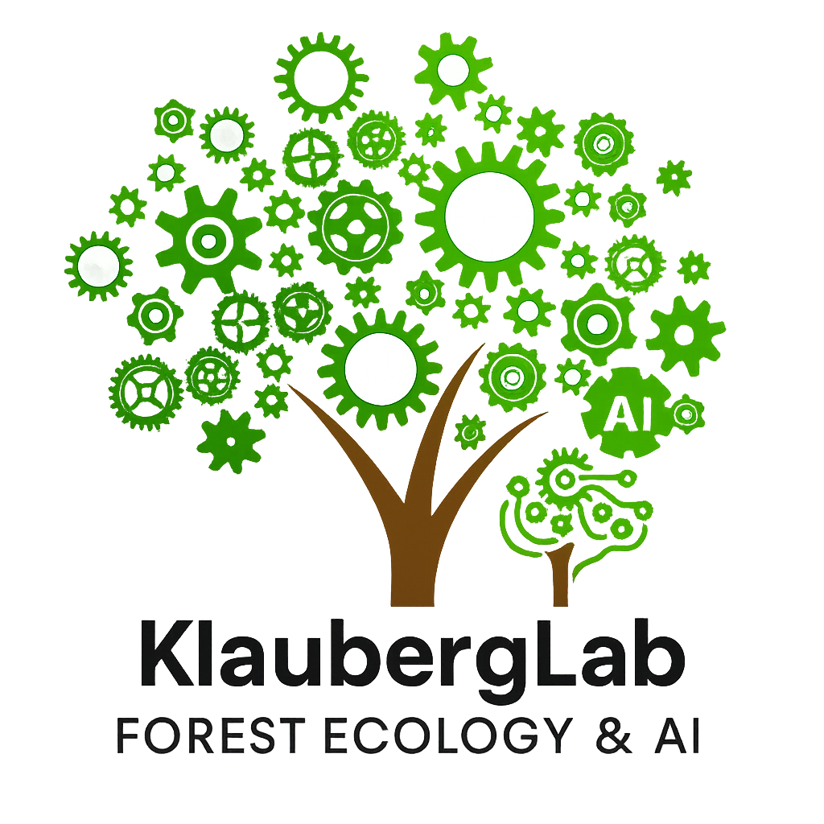
KlaubergLab
Forest Ecology and AI Lab

Slide 2
KlaubergLab
Forest Ecology, GIS and Artificial Intelligence Lab

Slide 3
KlaubergLab
Quantitative Forest Ecology, GIS and Artificial Intelligence Lab

Slide 4
KlaubergLab

Slide 5
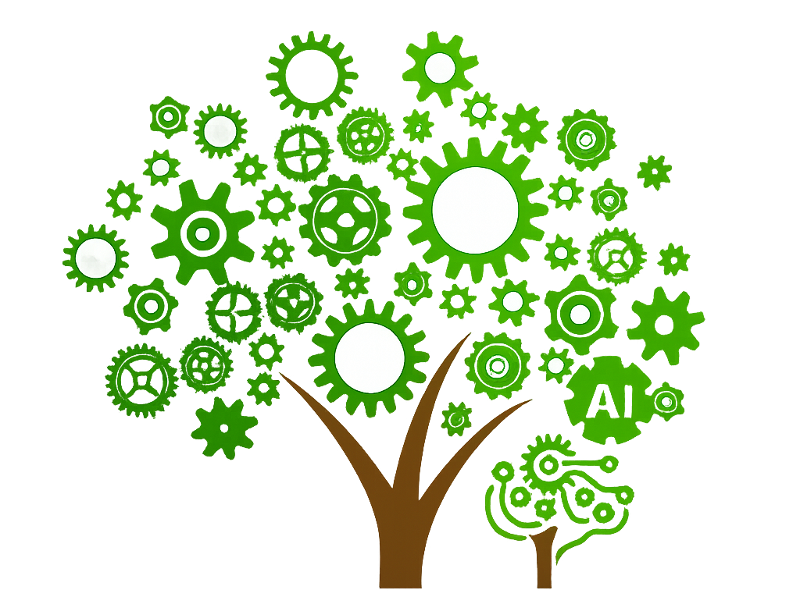
KlaubergLab
home-image1.jpghome-image1.jpg

Slide 7
